Slide 1
Data Analytics
Evolution of Analytic Processes
S.V.Jansi Rani
Assistant Professor / CSE
Notes:
The University of Adelaide, School of Computer Science
Chapter 2 — Instructions: Language of the Computer

Slide 2
Outline
Analytic Sandbox
Analytic Data Set (ADS)
EADS
Embedded Scoring

Slide 3

Analytic Sandbox
An analytic sandbox provides a set of resources with which in depth analysis can be done to answer critical business questions.
It is ideal for data exploration, development of analytical processes, proof of concepts & prototyping.
Benefits- view of analytic prof:
Independence
Flexibility
Efficiency
Freedom
Speed
Benefits from the view of IT
Centralization ,Streamlining, Simplicity, Control, Costs

Slide 4
Types of Sandbox
Internal Sandbox
External Sandbox
Hybrid Sandbox

Slide 5
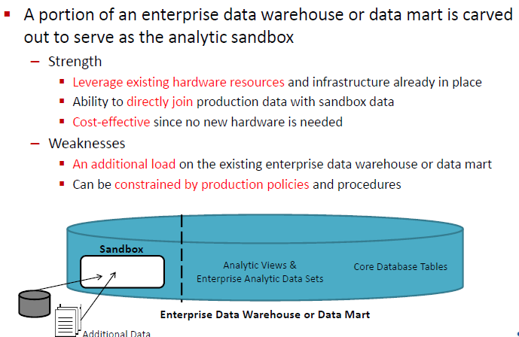
Internal Sandbox

Slide 6
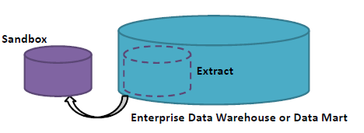
External Sandbox
For an external sandbox, a physically separate analytic sandbox is created for testing and development of analytic processes.
Strengths:
Simplicity
Flexibility in design & usage
Reduced workload management
Predictable & stable performance.
Weaknesses:
Additional cost of the stand alone system.
There will be some data movement.

Slide 7
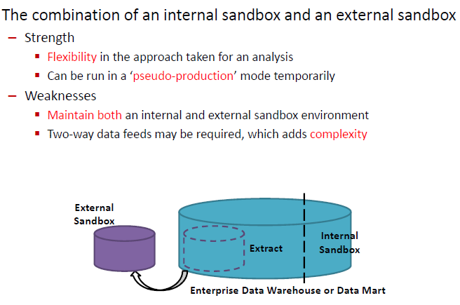
Hybrid Sandbox

Slide 8
Outline
Analytic Sandbox
Analytic Data Set (ADS)
EADS
Embedded Scoring

Slide 9
Analytic Data Set? (ADS)
An analytic data set is the data that is pulled together in order to create an analysis or model.
An ADS is generated by transforming, aggregating and combining data
The analytic data set helps to bridge the gap between efficient storage and ease of use.
Types of Analytic Data Set:
i) A Development ADS
ii) A Production ADS

Slide 10
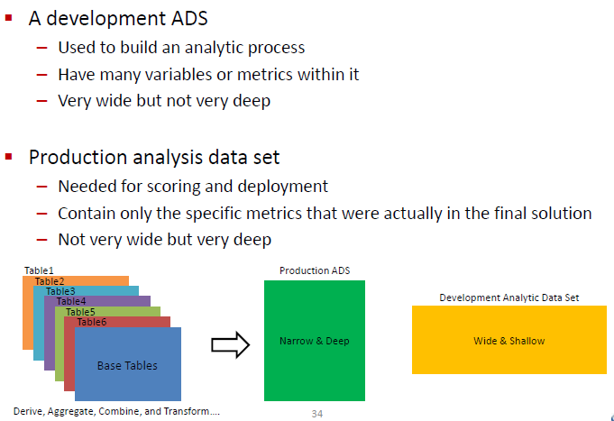
Types of ADS

Slide 11
Outline
Analytic Sandbox
Analytic Data Set (ADS)
EADS
Embedded Scoring

Slide 12
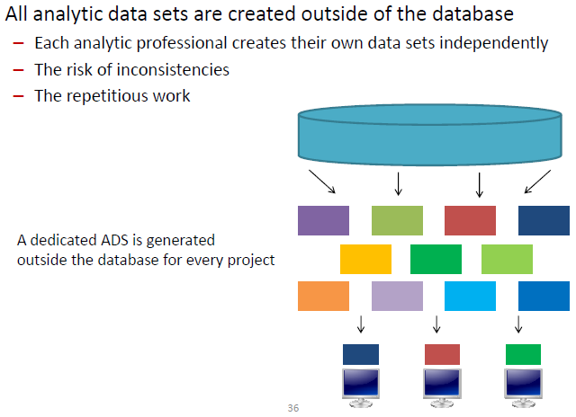
Traditional Analytic Data Sets

Slide 13
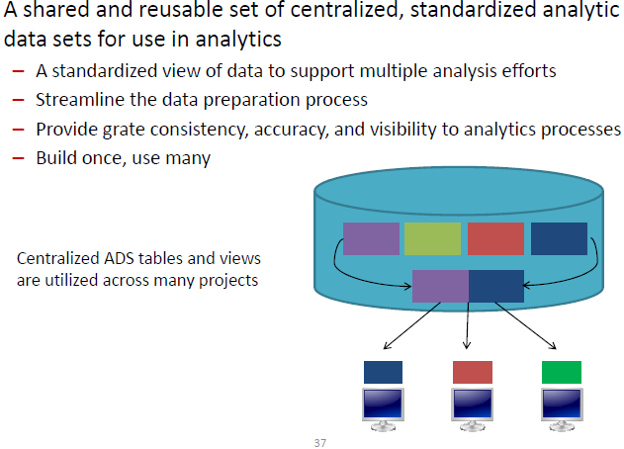
Enterprise ADS

Slide 14
When to create an EADS?
We can create an EADS for any entity on which we focus our analysis
Such entities include customers, products, locations, employees & suppliers.
An EADS evolves over time.
There will be time & cost associated with creating EADS.

Slide 15
Logical versus physical structures:
An EADS is logically one row per entity with dozens, hundreds or thousands of metrics.
The EADS might be physically stored so there is one table or view that has the sales metrics & one that has the demographic metrics & one that has the direct marketing metrics.

Slide 16
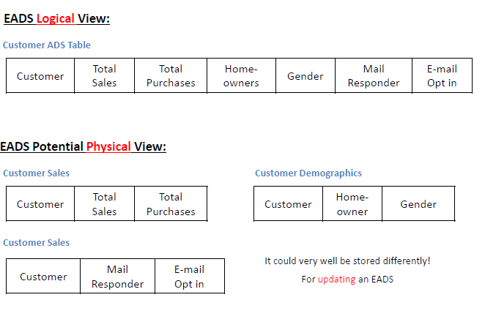

Slide 17
Summary tables
EADS has a set of summary tables that are updated via a scheduled process
Benefits to a table based EADS:
True compute.
Involve a heavy use of historical data.
Very low latency in getting data.
Drawbacks:
Will not be fully up to date with the latest data.
Use large disk space.
Update schedule for the various components will have to be determined.

Slide 18
Views
Benefits:
Completely fresh & updated.
Always getting the latest data.
If any changes are made to the EADS they will be immediately available.
Drawbacks:
The system load won’t be reduced.
Analytic professionals will have to wait longer to get their data back, since the data will be generated from the detailed data on demand instead of being precomputed.

Slide 19
Outline
Analytic Sandbox
Analytic Data Set (ADS)
EADS
Embedded Scoring

Slide 20
Embedded scoring
Score can be something generated from a predictive model or it can be any other type of output from an analytic process.
Embedded scoring enabled real time scoring.
Embedded scoring will abstract complexity from users.
Embedded scoring integration:
Methods apply for developing embedded scoring processes:
● SQL
● User defined function
● PMML
● Embedded processes

Slide 21
Analytic dataset inputs:
It is necessary to track the detail for each analytic data set or EADS that feeds into an analytic process.
Information track includes,
  The name of the SQL script, stored procedures, user defined function, embedded process, tables or views that will provide the data set to the user.
  The parameters
  The output tables and / or views.
  The relationship between each analytic data set.
Model definitions:
It is necessary to track a variety of information about each model or process.

Slide 22
Information track includes,
  The intended usage for the model.
  The history of the model
  The status of the model
  The type of the model.
  The scoring function for the model
  Information on the model input variables
Model validation & Reporting:
It is necessary to have a series of reports that help manage the models & processes over time.
Information tracked includes;
  Reports
  Specific summary statistics or validations.
  Model comparisons or variable distribution summaries

Slide 23
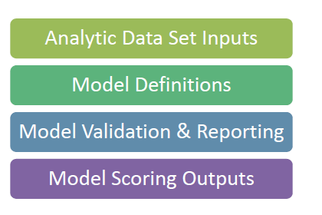
Model scoring output:
It is necessary to track are the model scores that are output from the scoring process.
Information track includes;
  The timestamp
  Historical scores & current scores

Slide 24
Thank You

